Slide 1
Pricing and Cost -
Big Mountain Ski Resort
Investigating revenue optimization

Slide 2
Current Situation
We have added an additional chairlift for this season, which will add an additional $1.5mm in operating costs for the year.
Our current operating costs include:
11 lifts
600 acres of man made snow
Projected 123 days open

Slide 3
Our objectives
In our analysis, we will be evaluating hundreds of ski resorts nationwide to evaluate which features most influence pricing. We are looking to increase profits by:
Identifying and promoting features which command the highest prices
Decrease operating costs on the features which influence pricing the least
Create an offset of $1.5mm or more without decreasing ticket prices

Slide 4
Findings
Our analysis has provided the following insights:
Our current ticket price of $81 is optimal, and should not be adjusted given our current features
Our greatest revenue generators are the number of runs, our vertical drop and our skiable area
The closure of runs, however, does not appear to influence ticket sales. Therefore we can realize a significant operational cost savings by closing select runs and lifts on a given day.

Slide 5
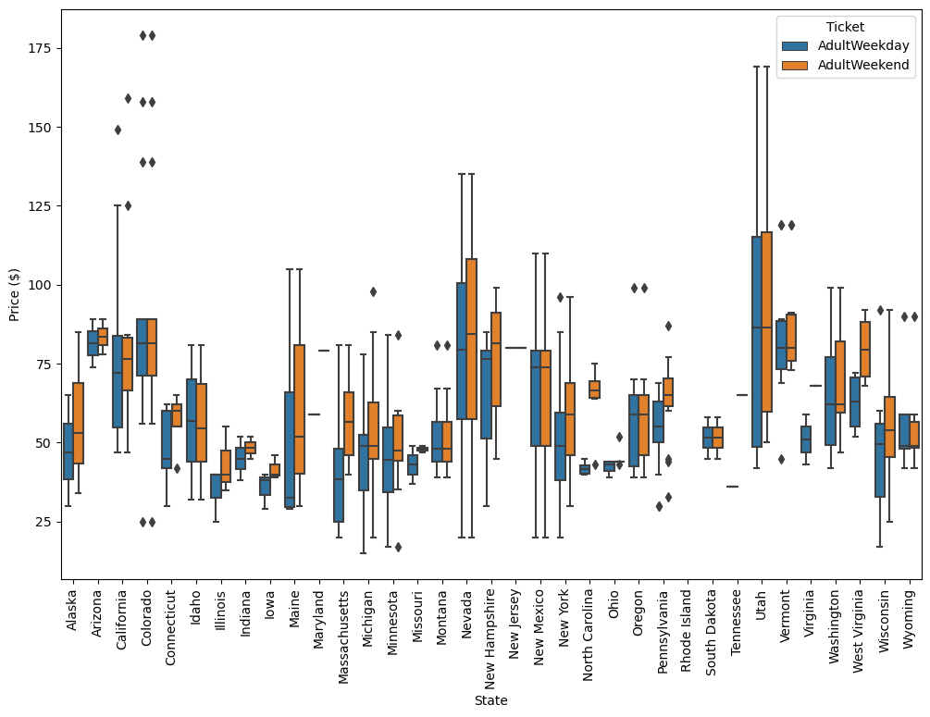
Modeling Results - State Pricing Breakdown

Slide 6
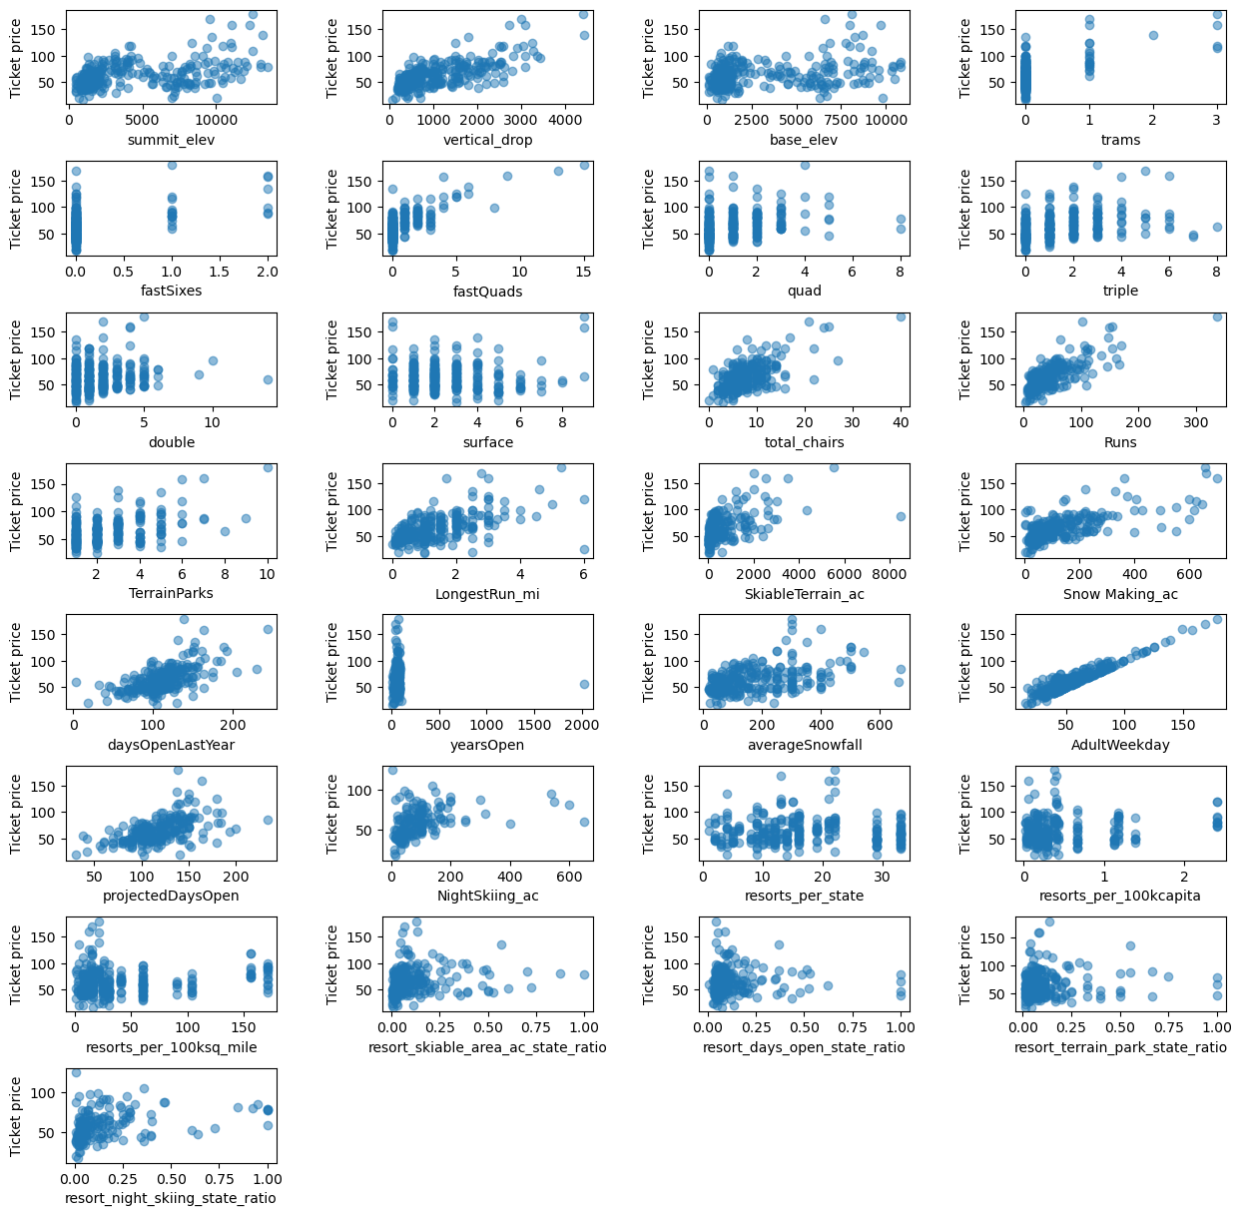
Modeling Results - Revenue Driving Features
Here we see a total breakdown of all features.
Don’t be intimidated by the clutter - we will
be looking at the four greatest drivers in our
next slide, along with where Big Mountain
falls in comparison.

Slide 7
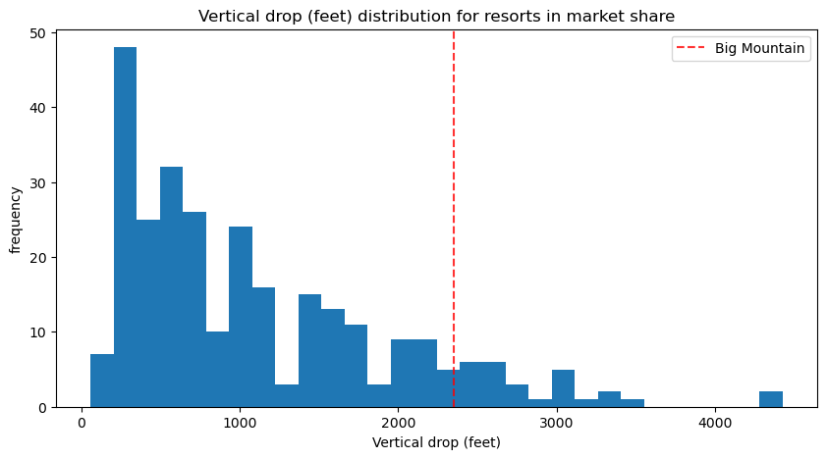
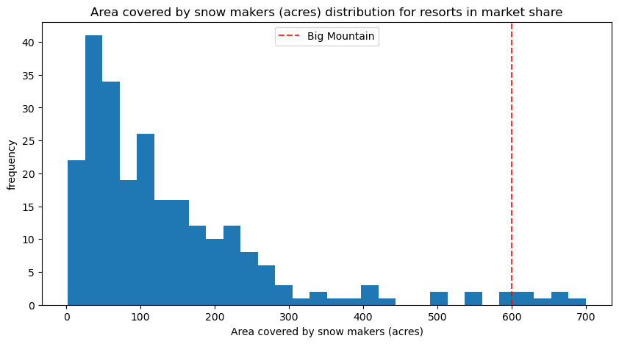
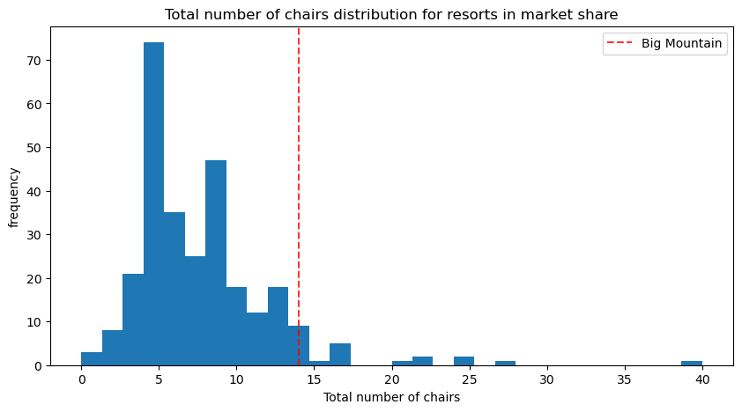
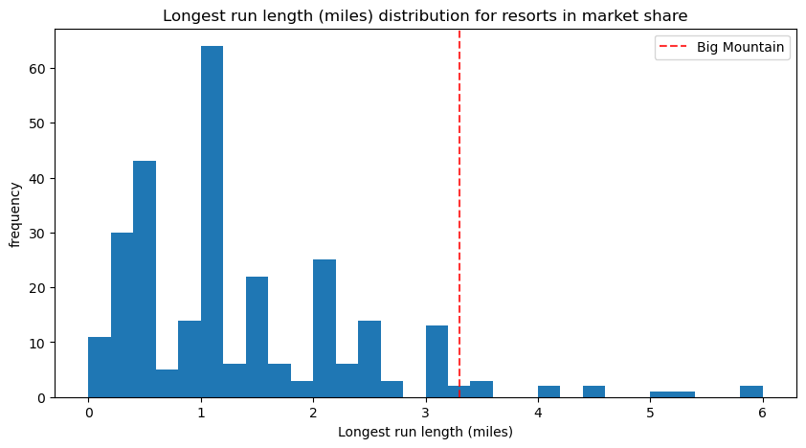
Modeling Results - Revenue Driving Features (cont.)

Slide 8
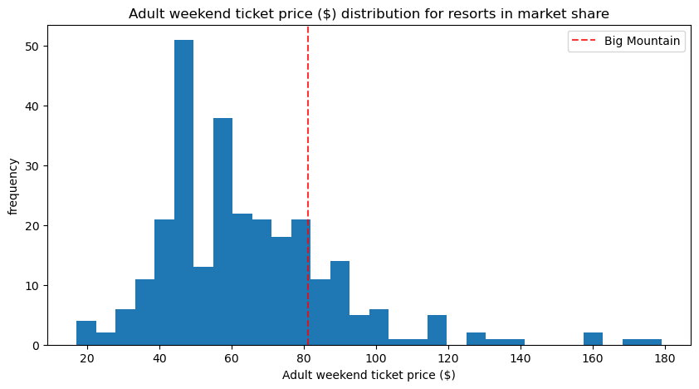
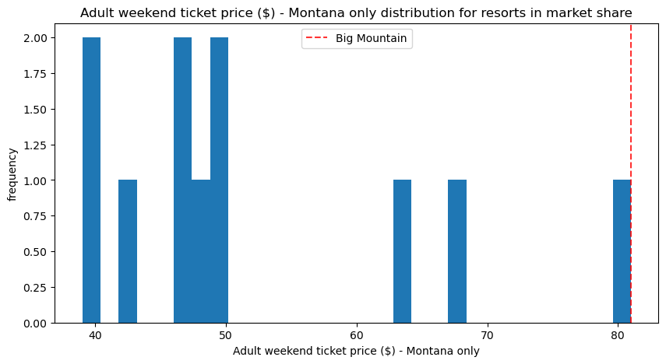
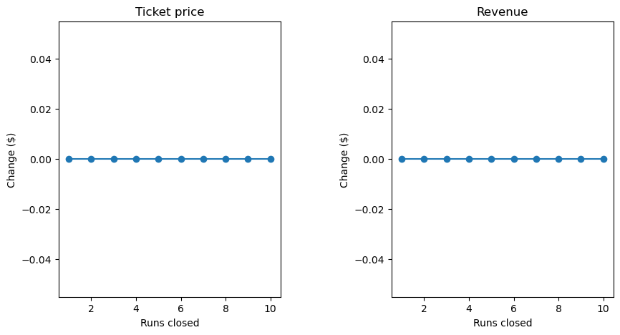
Modelling Results - Current Pricing Comparison

Slide 9
Conclusion
Based on our analysis, we can confidently draw the following conclusions:
Big Mountain is a leader in the national ski resort market in several of the key revenue driving features
Within the Montana market, Big Mountain is already the most expensive ticket, and we cannot confidently raise the ticket price further without losing revenue in overall ticket sales
The market is very inelastic with respect to run closures, and so while it is a revenue driving feature, we can safely close several runs at a time to lower operation costs without losing revenue in ticket sales.

